Slide 1
static keyword in java
Static Block
Static Variables
Static methods
Static class
momedaram

Slide 2
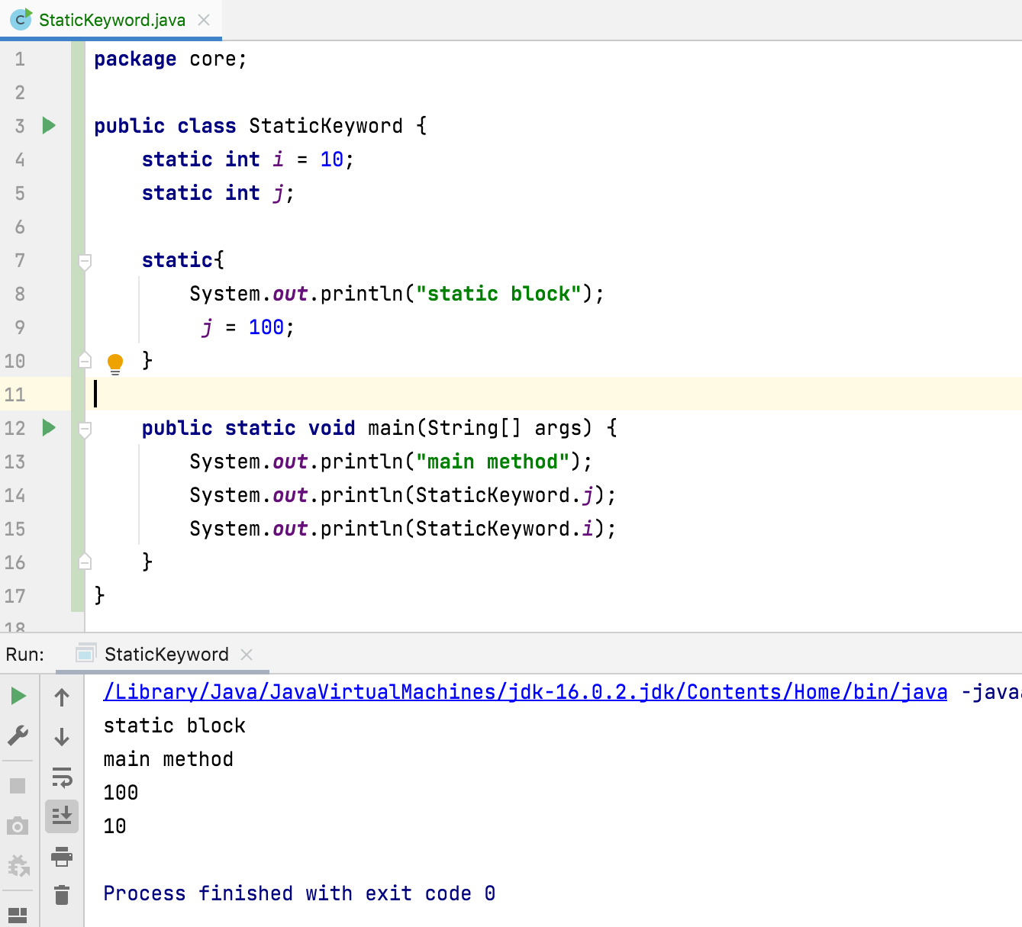
static block
static block is a block of statements inside a Java class that will be executed before the main method at the time of class loading.

Slide 3
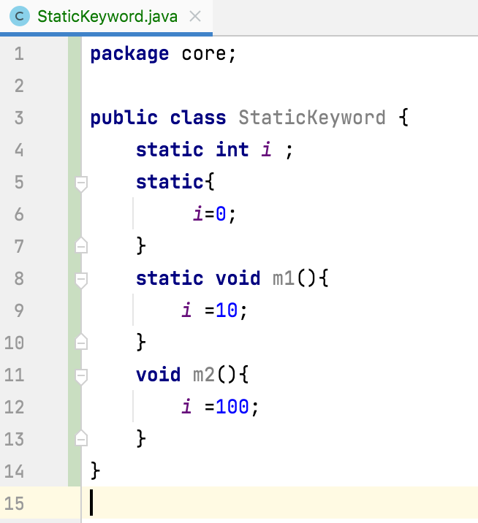
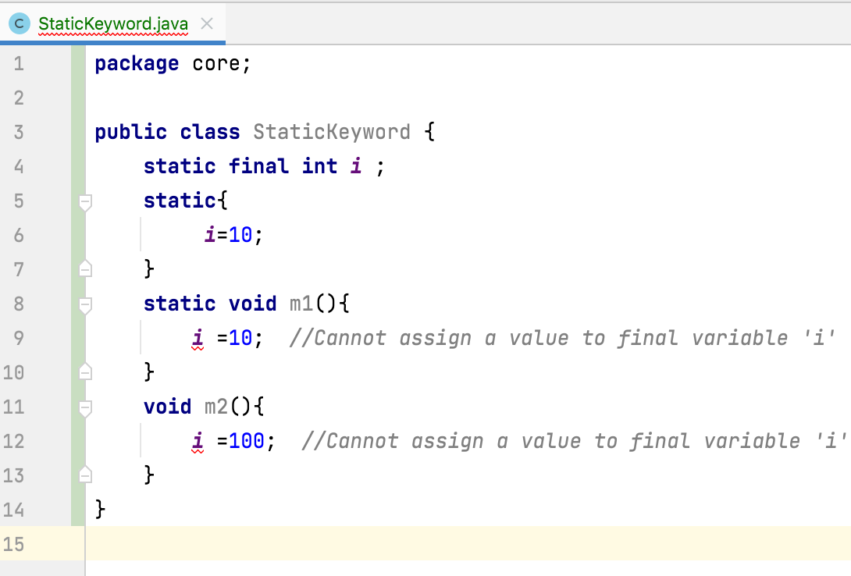
Static block
static block Is used to initialize the static data member.

Slide 4
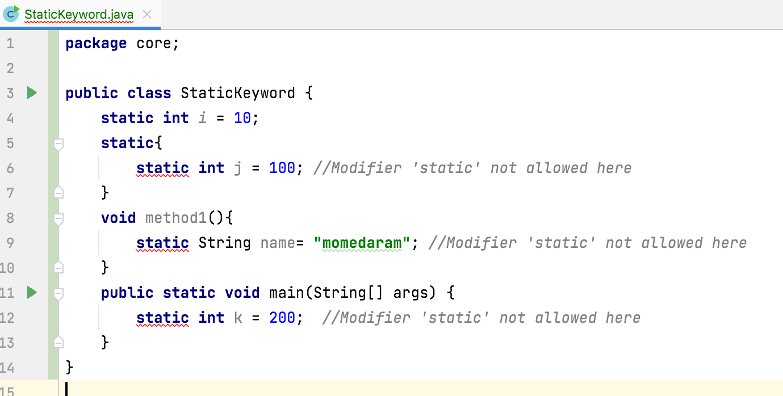
Static variable
static variable gets memory only once in the class area at the time of class loading.
Static variables can be created at class-level only.

Slide 5
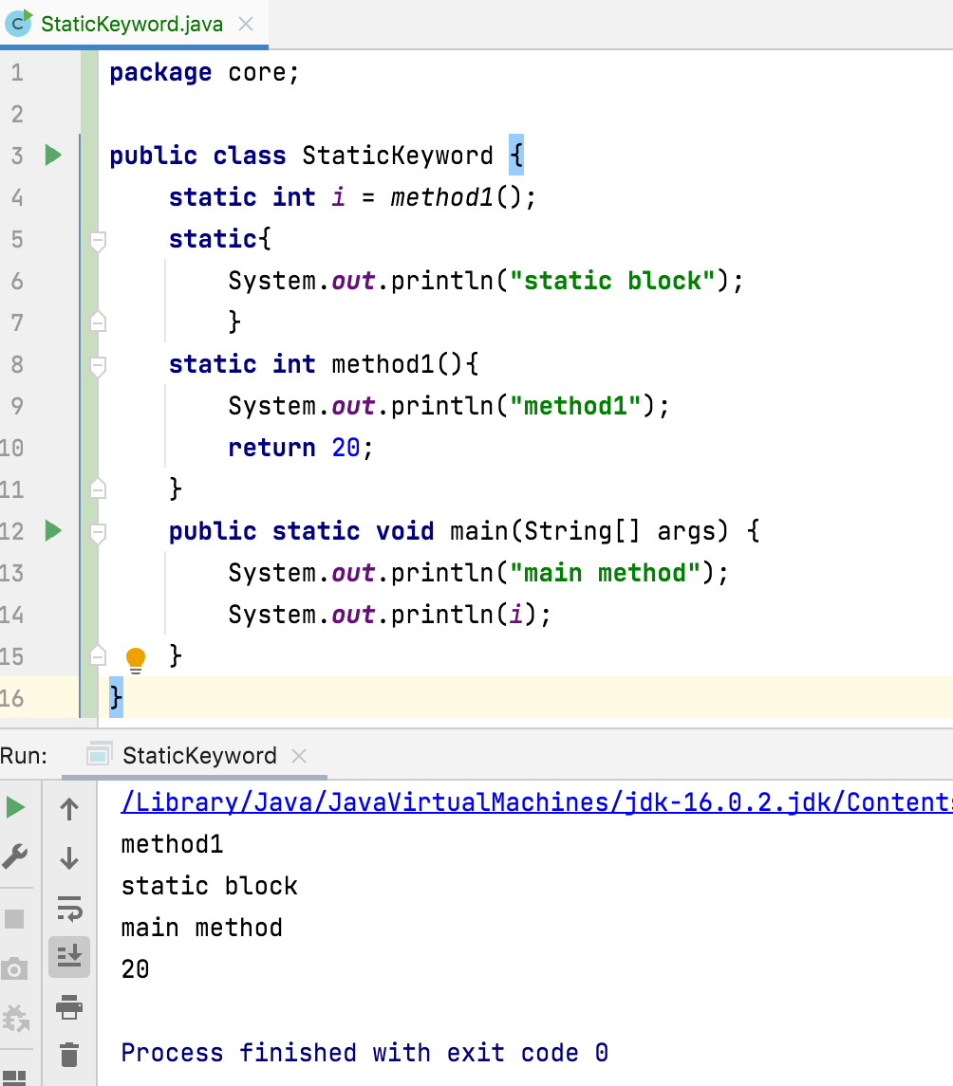
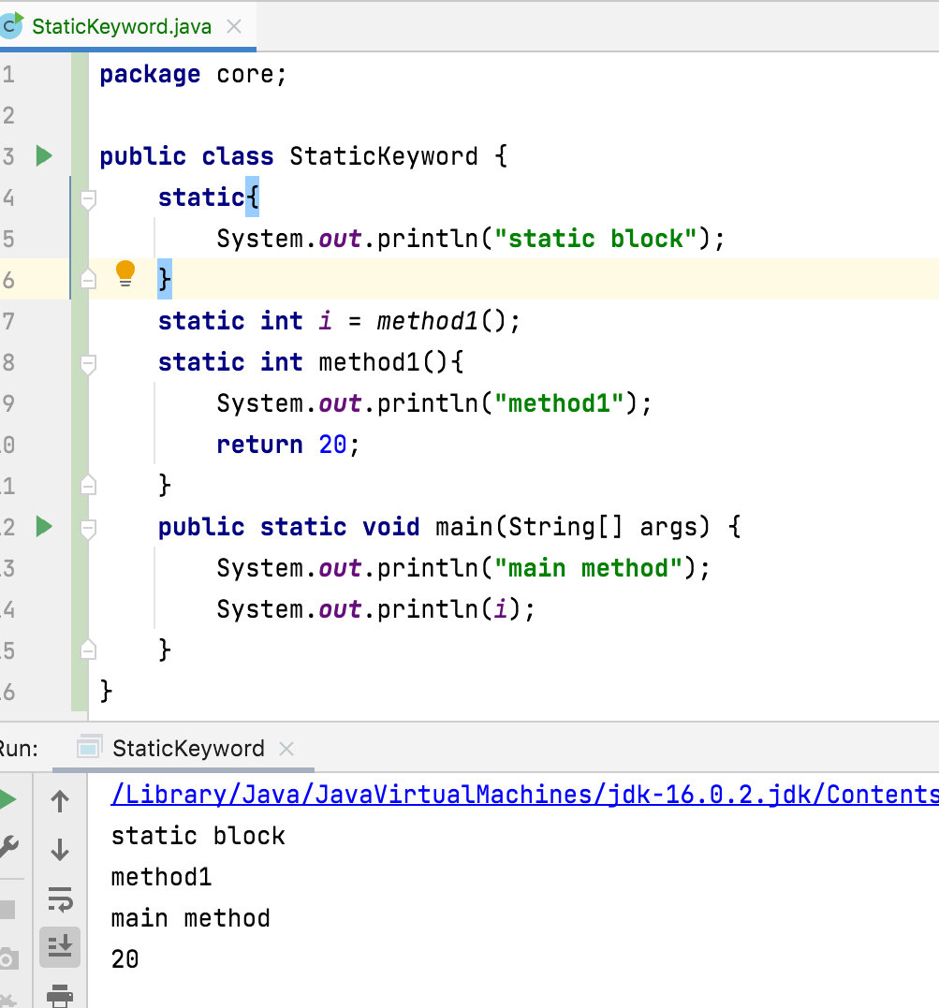
static block and static variables are executed in the order they are present in a program.

Slide 6
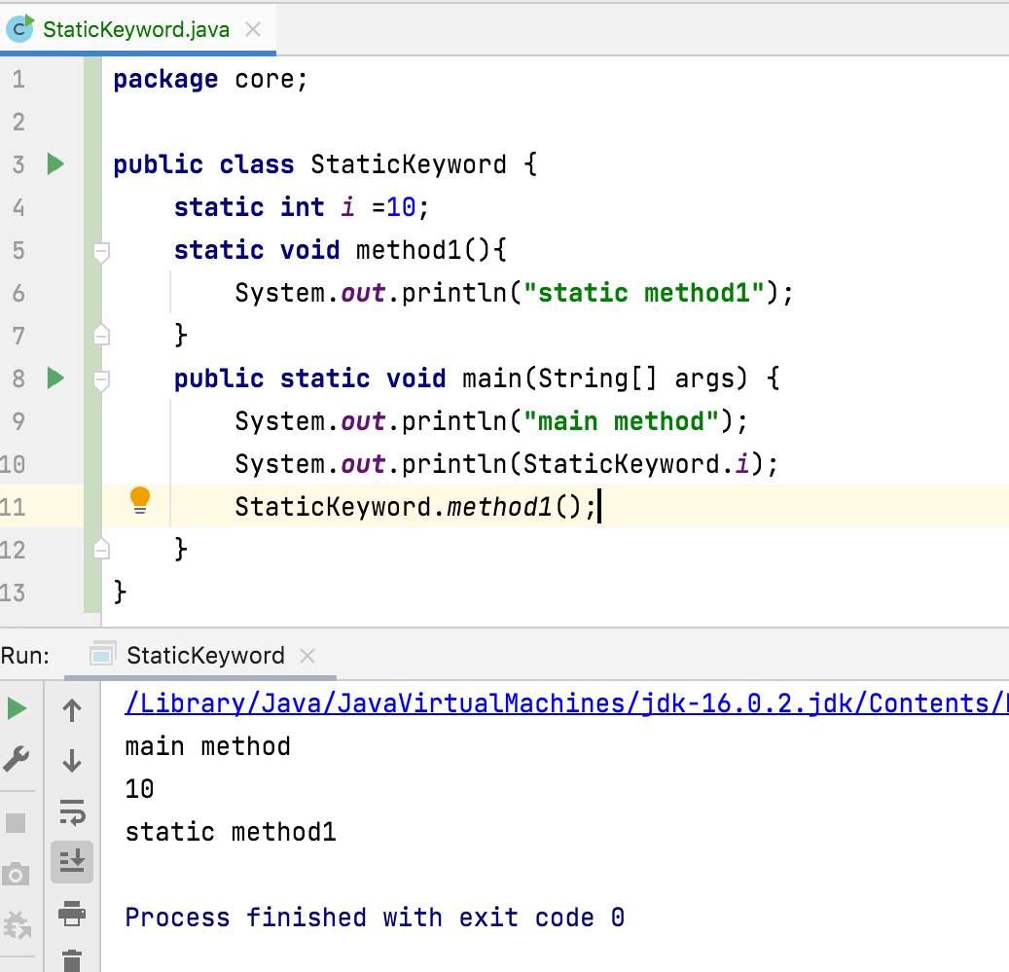
Static method
The most common example of a static method is the main( ) method
A static method can be invoked without creating an instance of a class.

Slide 7
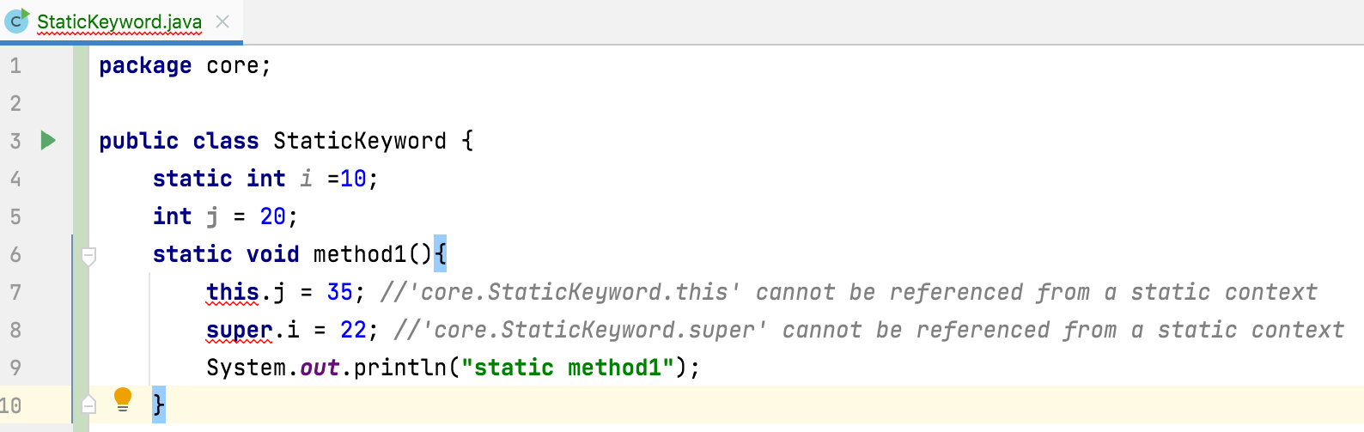
Static method
Static methods cannot refer to this or super in any way.

Slide 8
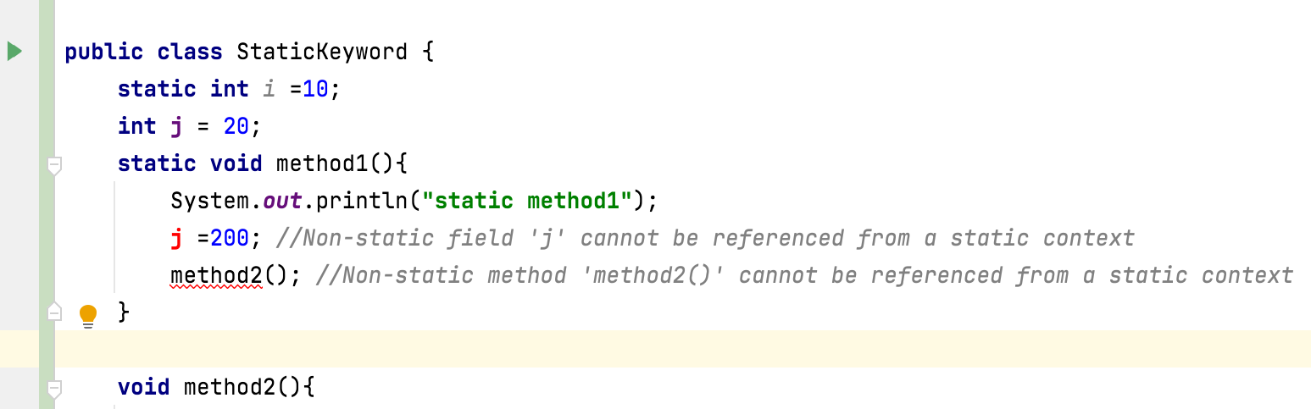
Static method
Can’t access non static from static context

Slide 9
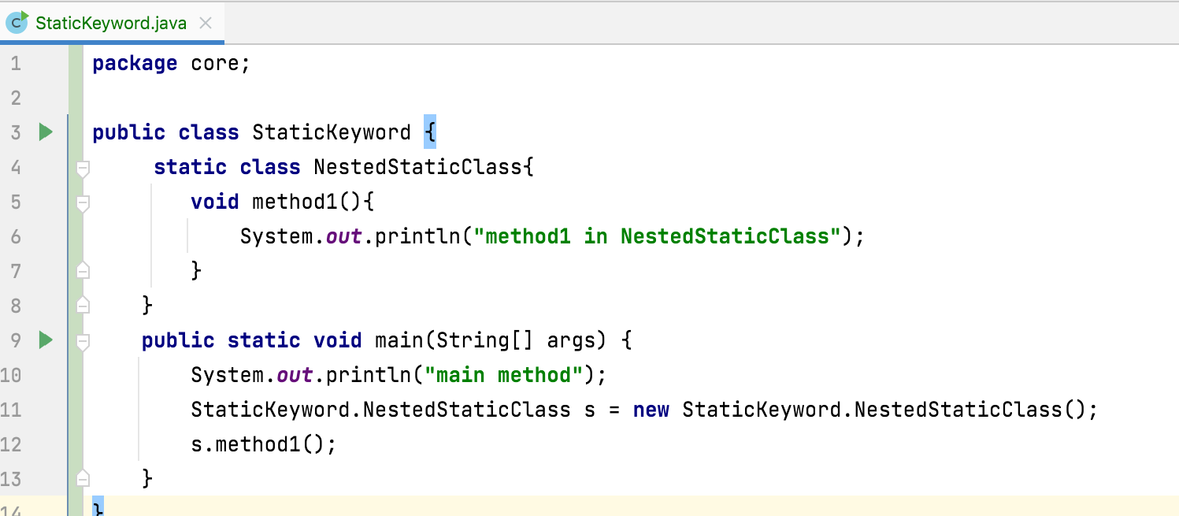
Static class
A class can be made static only if it is a nested class
Nested static class doesn’t need a reference of Outer class.
Non-static context cannot be referenced from a static context

Slide 10
Thank you !
momedaram

